Slide 1
Unit conversion in LBM
Arman Safdari

Slide 2

outline

Slide 3
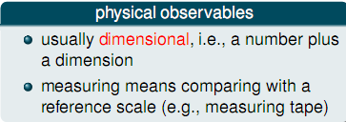
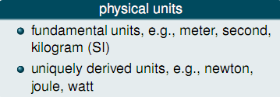
PHYSICAL OBSERVABLES AND UNITS

Slide 4
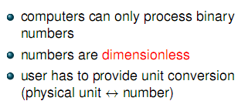
Computers and physical units
Notes:
LBM is new & has been confined to physics literature, until recently.

Slide 5
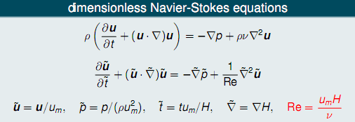
Dimensionless Navier-Stokes Equation
Notes:
As you can see most of the LBM literature is in math or physics, very little is found in earth sciences.

Slide 6


Conversion Principle
Notes:
This diagram gives a quick overview of LBM’s capabilities. It can simulate simple fluid flow such as streamlines, or multiphase flow such as a water and it’s own vapour. It can simulate immiscible fluids such as oil and water, or what I will be showing today, miscible fluids such as .

Slide 7

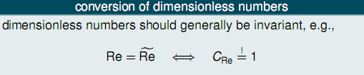
Conversion Principle

Slide 8
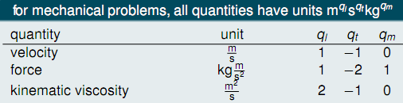
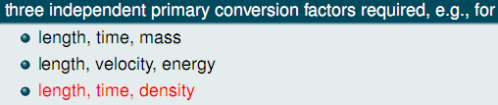
Primary conversion factors

Slide 9
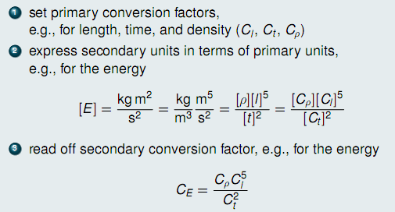
Finding secondary Conversion Factors

Slide 10
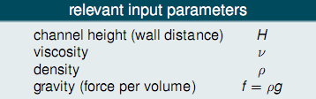
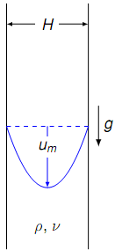
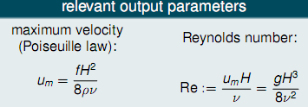
Example Discussion

Slide 11
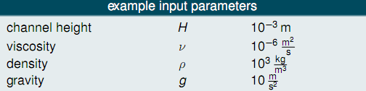

Choose Physical Parameters

Slide 12



Choose Simulation Parameters

Slide 13



Make Use Of Reynolds Number
Notes:
The collision step is difficult to portray but is essentially the difference between the distribution function at that node and the distribution of the equilibrium state of the particles (fluid) at the same node.

Slide 14



Time Conversion Factor

Slide 15



Velocity Conversion Factor

Slide 16

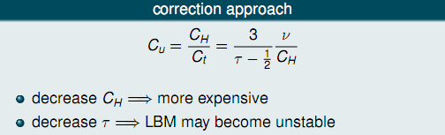
Check the Correct Simulation Parameters

Slide 17



Correction the Parameters Example

Slide 18


Force Conversion Factor

Slide 19
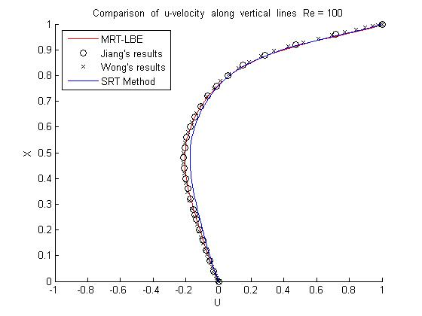
Results
CMWR 2004
Notes:
This represents the mixing that would occur when saltwater is sitting on top of freshwater.

Slide 20
Thank you

