Slide 1
particles motion
Prepared by:
Arman Safdari

Slide 2
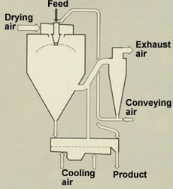
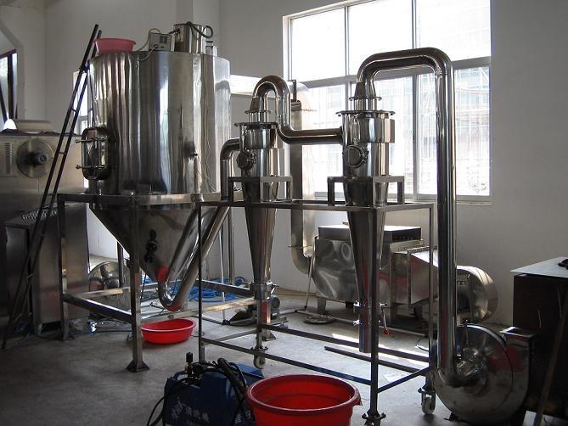
Industrial Application
Spray drying

Slide 3
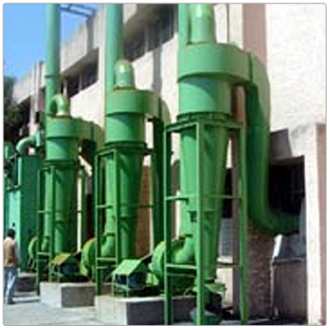
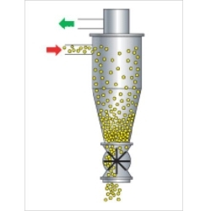
Cyclone separator (pollution control)

Slide 4
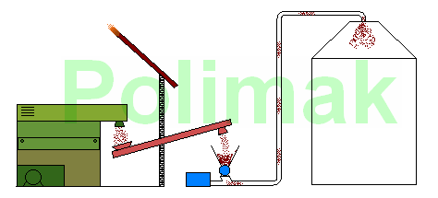
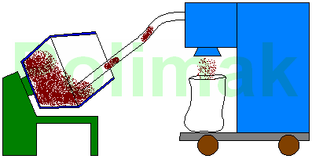
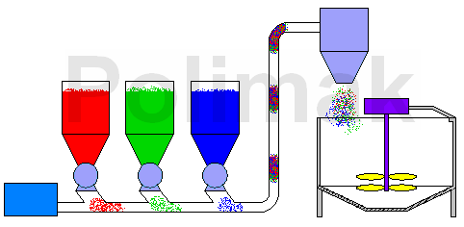
Pneumatic transport

Slide 5
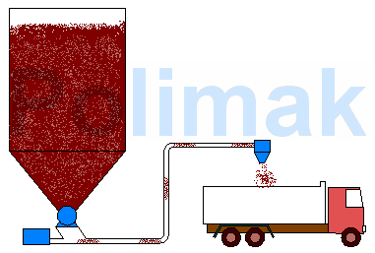
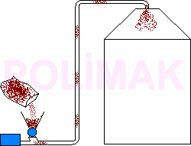
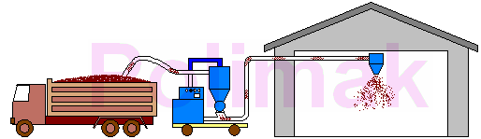
Transport systems

Slide 6
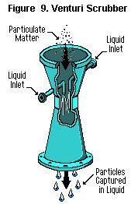
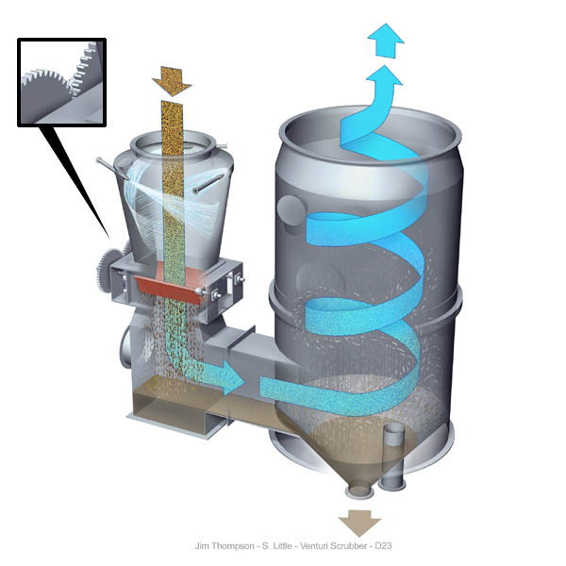
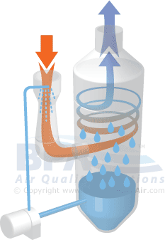
Venturi scrubber

Slide 7
Manifold and fuel injection systems
1- carburetor
2- fuel injection in inlet manifold
3- FSI
some videos are available

Slide 8
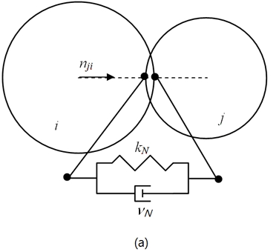
Particle equations
Contact force (Normal vector force)
Damping force (Normal vector force)
Contact force (tangential force)
Damping force ( tangential force)

Slide 9
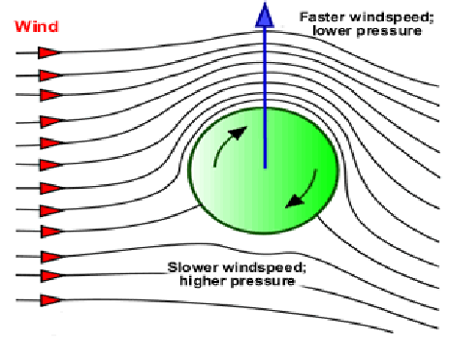
Magnus force
The Magnus effect is the phenomenon whereby a spinning object flying in a fluid creates a whirlpool of fluid around itself.
A video is available

Slide 10
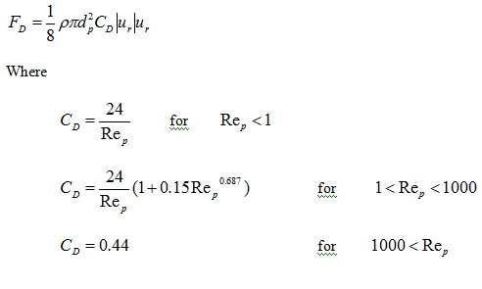
Drag force

Slide 11
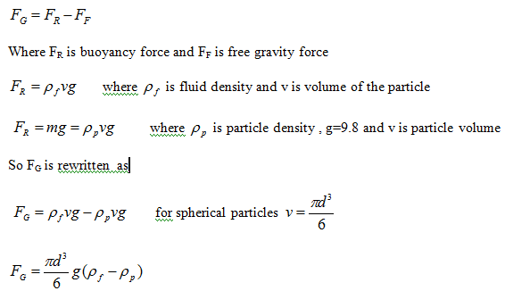
gravitational force

Slide 12
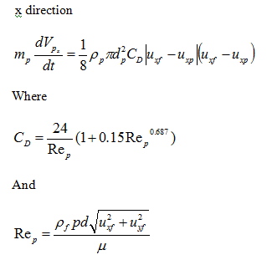
Particle forces equation

Slide 13
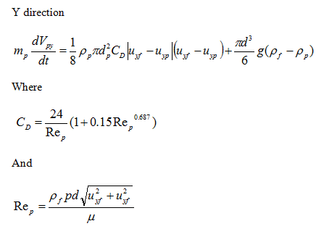
Particle forces equation

Slide 14
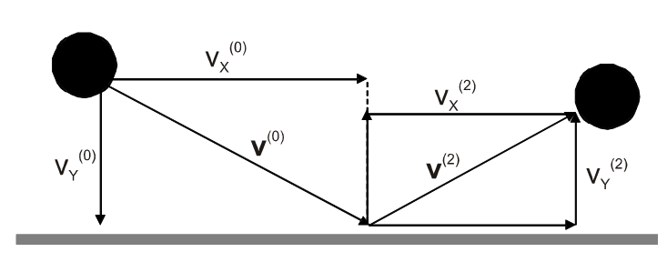
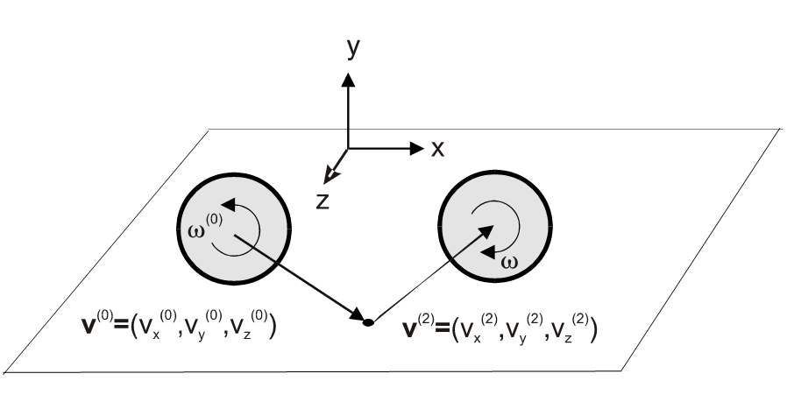
Particle-Wall interaction

Slide 15
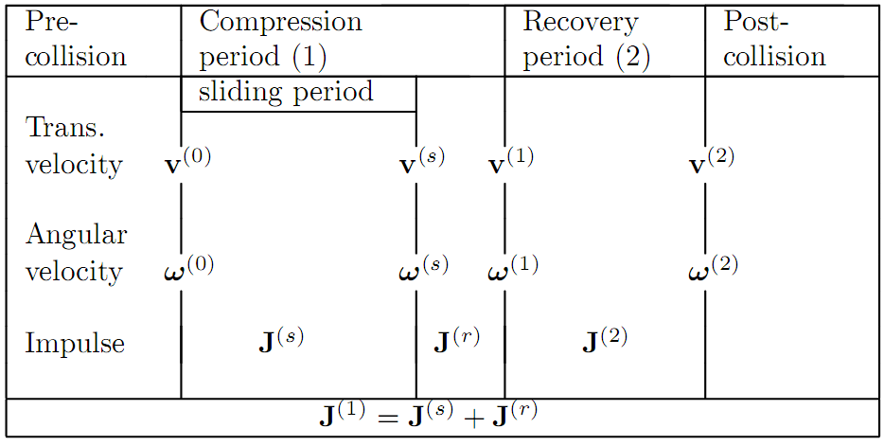
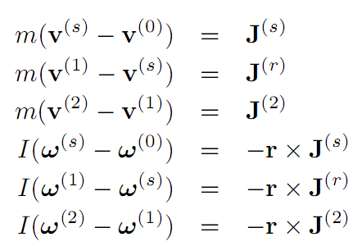
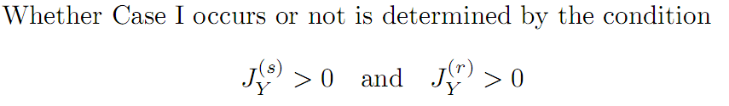
Case 1 :
The particle stops sliding in the compression period

Slide 16
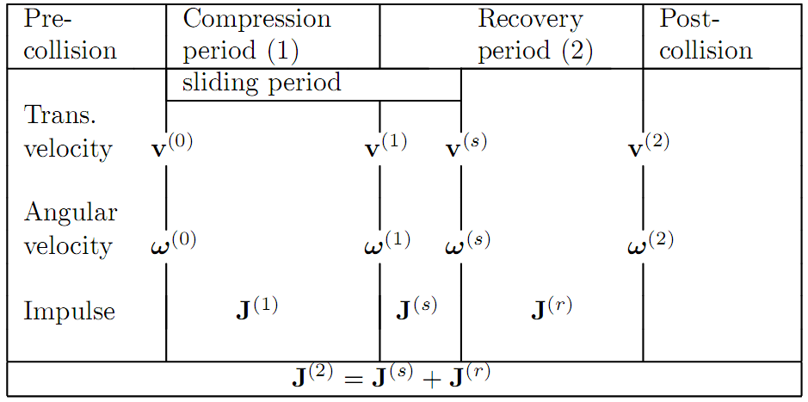
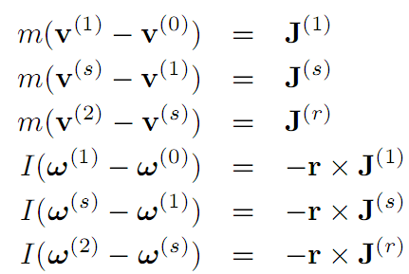
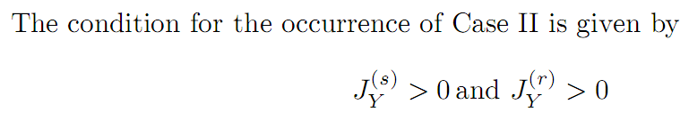
Case 2 :
The particle stops sliding in the recovery period

Slide 17
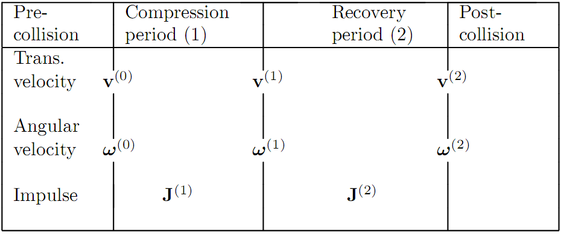
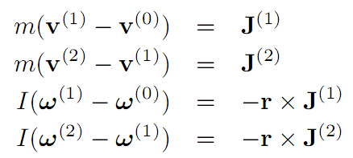
Case 3 :
The particle continues to slide throughout the compression and recovery periods

Slide 18
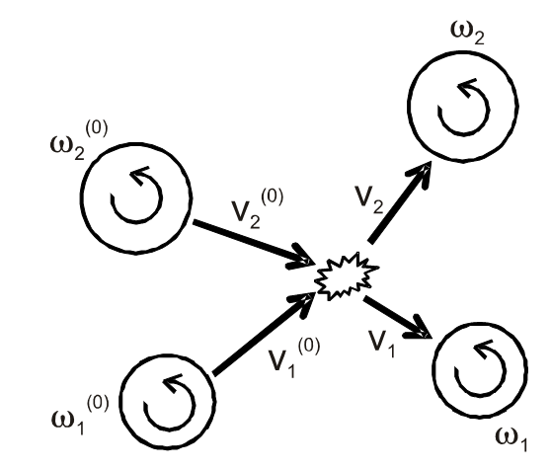
Particle-Particle interaction
- Hard sphere model
- Soft sphere model

Slide 19
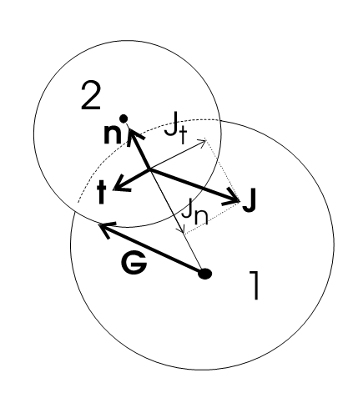
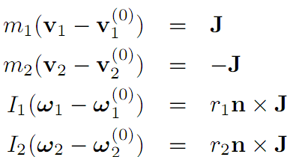
Hard sphere model

Slide 20
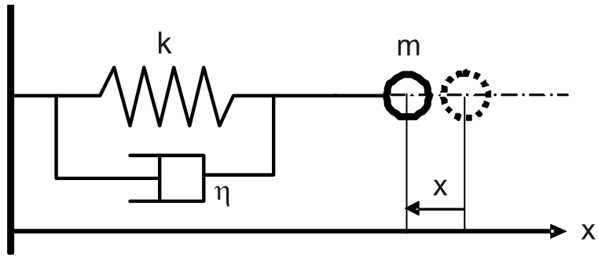

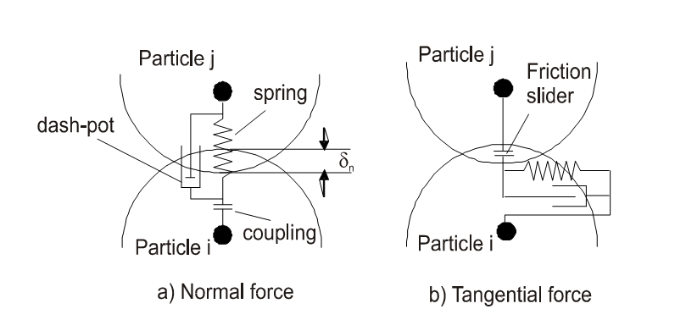
Soft sphere model

Slide 21
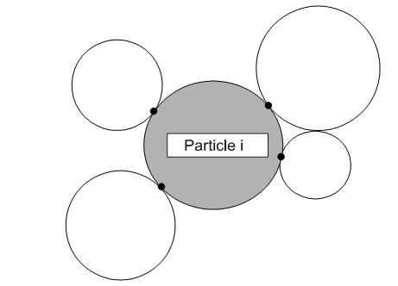
Stickiness particle (Cohesive force)
Inter-particle forces due to the wetness of particle surfaces, due to electrostatic
charges and the van der Waals’ forces are known to cause adhesion of particle
To a wall or to another particle

Slide 22
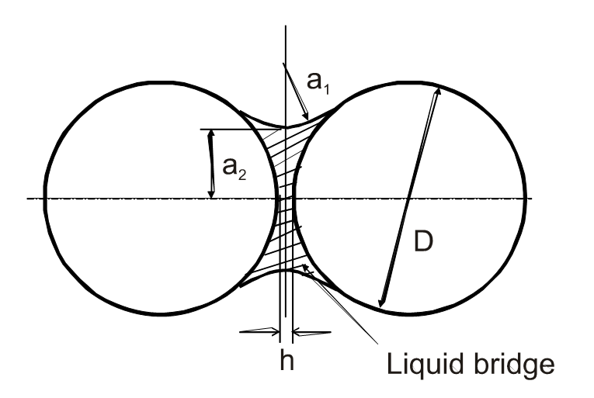
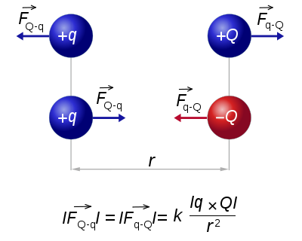
- Force due to a liquid bridge
- Electrostatic force

Slide 23
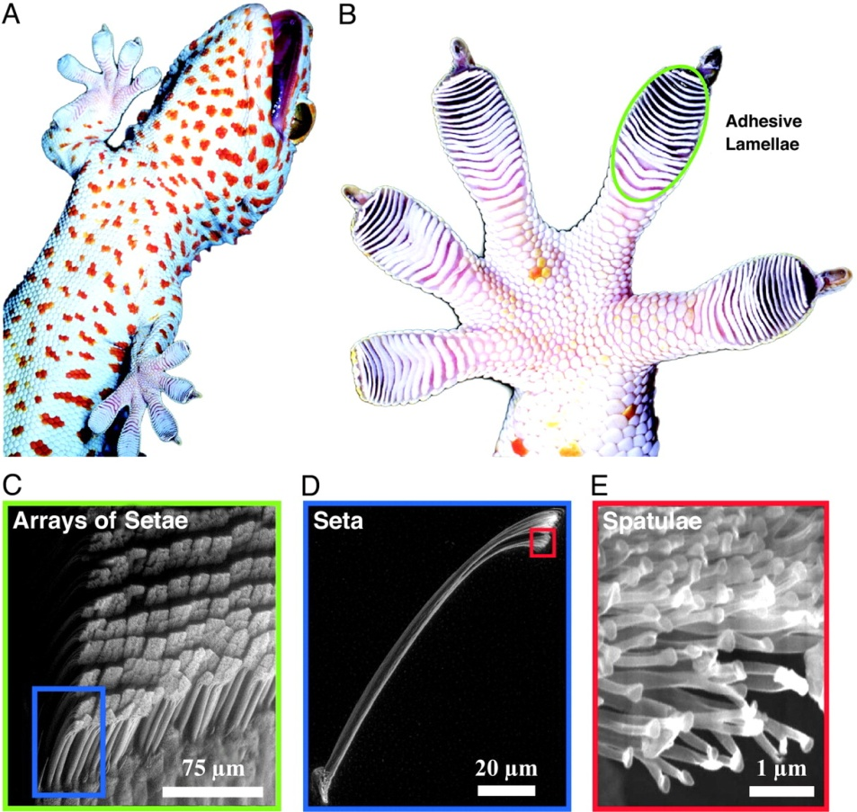
- Van der Waals forces
Molecules can attract each other at moderate distances and repel each other at close range. The attractive forces are collectively called "van der Waals forces"
Adhesive foot hairs, or setae, on the tokay gecko are remarkably sticky: a single seta can generate up to200 (micro N) of force. Geckos use this adhesive to rapidly and repeatedly navigate a wide variety of surfaces. They can even climb vertically on smooth surfaces at a speed >1 m/s.

Slide 24
Solid particle agglomeration
Agglomeration of solid particles occurs, when two particles collide and deform, energy is dissipated during collision.
If the energy dissipated is greater than the impact kinetic energy, there is no energy available for particle rebound.
Because of different morphologies and shapes, it is virtually impossible to determine the fluid dynamic forces on the agglomerates.
A video is available

Slide 25
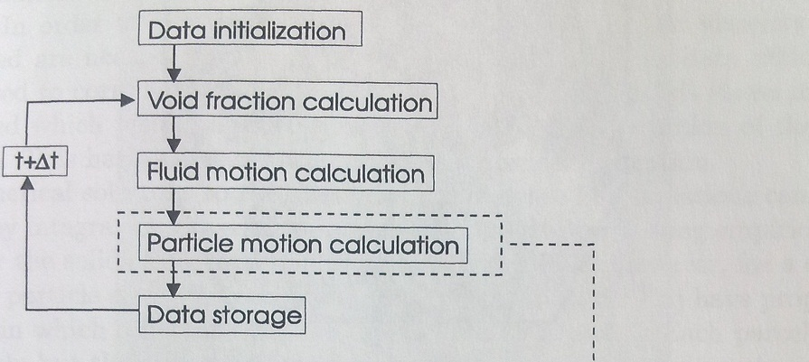
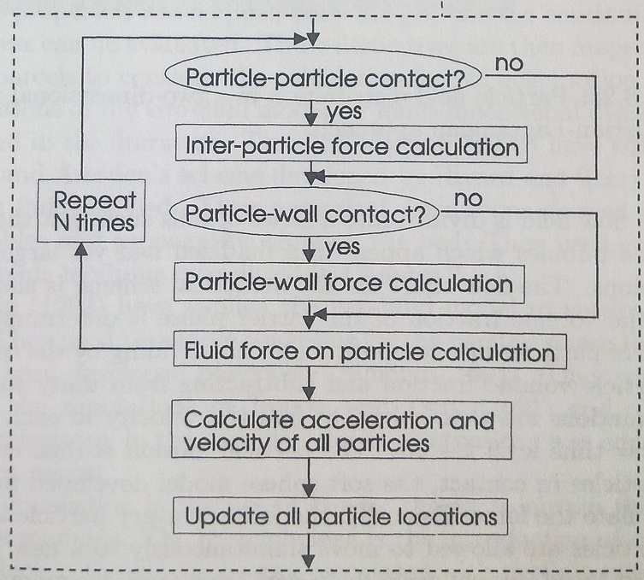
Algorithm of particles collision

Slide 26

Thank you

