Slide 1
3D Simulation of particle motion in lid-driven cavity flow by MRT LBM
Arman Safdari

Slide 2

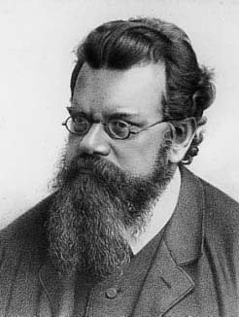
Ludwig Eduard Boltzmann
Born in Vienna 1844
University of Vienna 1863
Ph.D. at 22
University of Graz 1869
Died September 5, 1906

Slide 3
Lattice Boltzmann aim
The primary goal of LB approach is to build a bridge between the microscopic and macroscopic dynamics rather than to dealt with macroscopic dynamics directly.

Slide 4
LBM Literature
Notes:
LBM is new & has been confined to physics literature, until recently.

Slide 5
LBM Usage in Various Fields
LBM is new & has been mostly confined to physics literature, until recently.
Notes:
As you can see most of the LBM literature is in math or physics, very little is found in earth sciences.

Slide 6
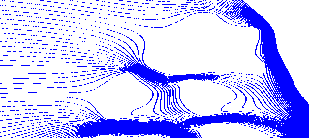
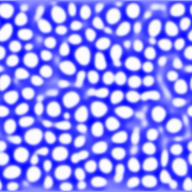


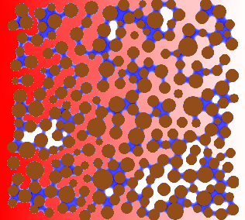


LBM Capabilities
Streamlines
Phase Separation
Single Phase
(No Interaction)
Single Component Multiphase
Interaction Strength
Number of Components
No combine Fluids/Diffusion (No Interaction)
No combine Fluids
Oil & water
Diffusion
Notes:
This diagram gives a quick overview of LBM’s capabilities. It can simulate simple fluid flow such as streamlines, or multiphase flow such as a water and it’s own vapour. It can simulate immiscible fluids such as oil and water, or what I will be showing today, miscible fluids such as .

Slide 7
The Boltzmann Equation
Advection terms
Collision terms
f : particle distribution function
c : velocity of distribution function
Equation describes the evolution of groups of molecules

Slide 8
BGK (Bhatnagar-Gross-Krook) model
most often used to solve the incompressible Navier-Stokes equations
a quasi-compressible come, in which the fluid is manufactured into adopting a slightly compressible behavior to solve the pressure equation
can also be used to simulate compressible flows at low Mach-number
It perform easily as well as its reliability

Slide 9
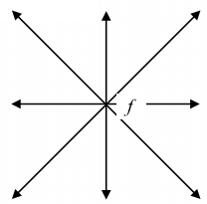
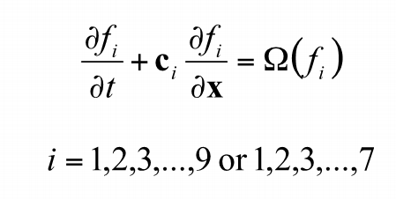
Discrete velocity model
9 velocity model
7 velocity model
The direction of distribution function is limited to seven or nine directions

Slide 10
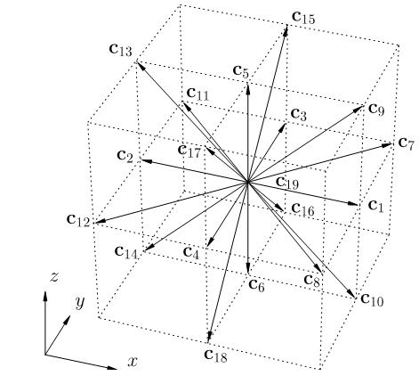
3D Lattice
14
4
12
27 components, and 26 neighbors
19 components, and 18 neighbors
15 components, and 14 neighbors
2
25
0
18
9
6
21
15
8
22
23
11
16
20
5
10
13
3
24
1
19
7
17

Slide 11
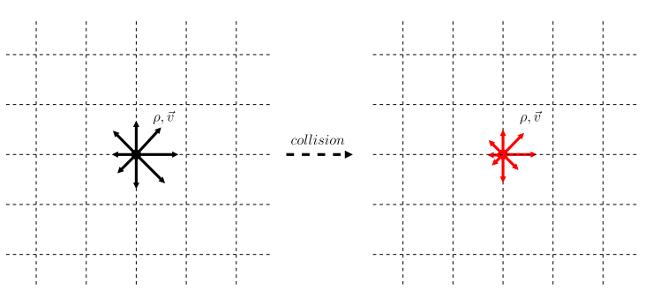
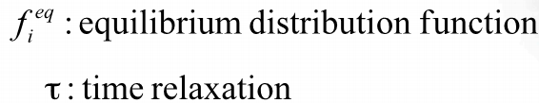
Bhatnagar-Gross-Krook(BGK) Collision model

Slide 12


BGK Boltzmann equation
Equilibrium distribution function

Slide 13
Collision and Streaming
Streaming
Collision
w_{a} are 4/9 for the rest particles (a = 0),
1/9 for a = 1, 2, 3, 4, and
1/36 for a = 5, 6, 7, 8.
τ relaxation time
c maximum speed on lattice (1 lu/ts)
Notes:
The collision step is difficult to portray but is essentially the difference between the distribution function at that node and the distribution of the equilibrium state of the particles (fluid) at the same node.

Slide 14
Streaming
Notes:
The movement of these particles are broken up into streaming (simple movement of the particles from one node to another) and collision (when particles hit each other).
This animation is an good depiction of the streaming step.

Slide 15
MRT (Multiple-Relaxation-Time) model
The BGK collision operator acts on the off-equilibrium part multiplying all of them with the same relaxation. But MRT can be viewed as a Multiple-Relaxation-Time model
Regularized model
better accuracy and stability are obtained by eliminating higher order, non-hydrodynamic terms from the particle populations
This model is based on the observation that the hydrodynamic limit only on the value of the first three moments (density, velocity and stress tensor)
Entropic model
The entropic lattice Boltzmann (ELB) model is similar to the BGK and the main differences are the evaluation of the equilibrium distribution function and a local modification of the relaxation time.

Slide 16




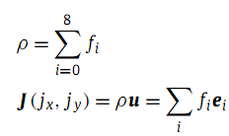
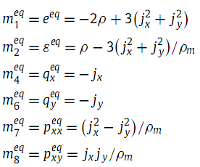
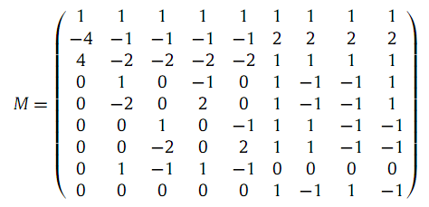
Mrt Lattice Boltzmann Method D2Q9

Slide 17
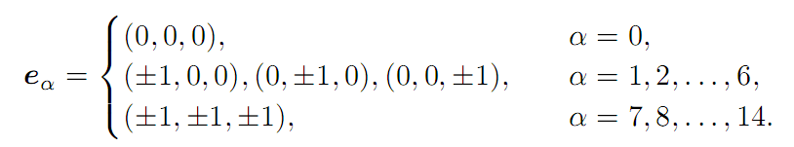

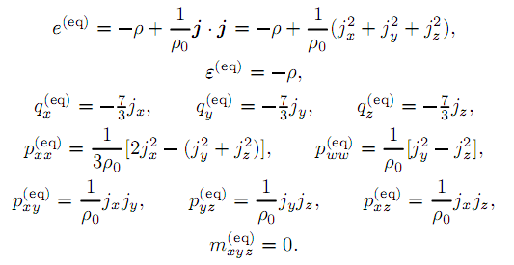

Mrt Lattice Boltzmann Method D3Q15

Slide 18
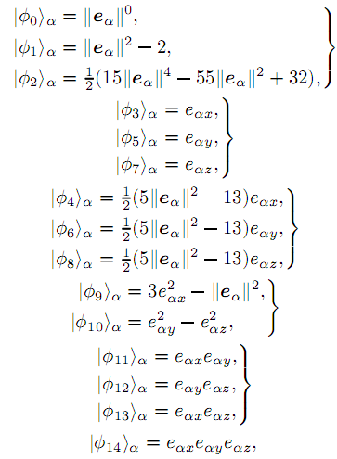
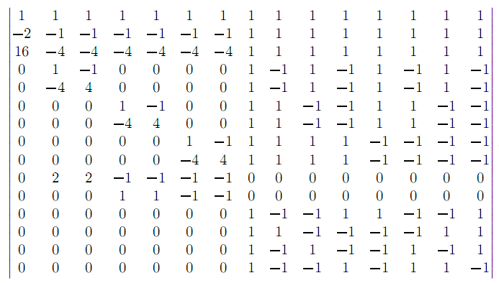
So the matrix M is then given by :

Slide 19
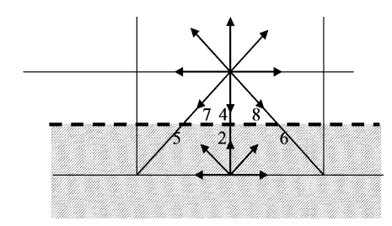
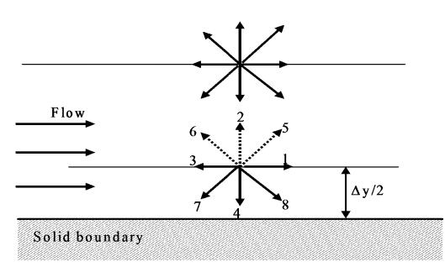
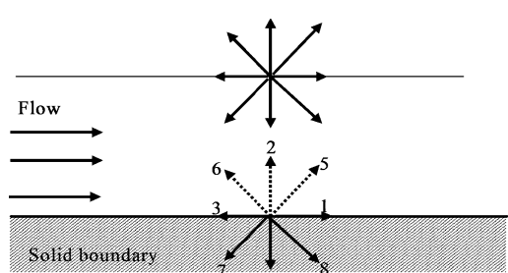
Boundary Condition
1-Bounce Back
Bounce back is used to model solid stationary or moving boundary condition, non-slip condition, or ﬂow-over obstacles.
Type Of Bounce Back BC
1
2
3

Slide 20


2-Equlibrium and Non-Equlibrium Distribution Function
The distribution function can be split in to two parts, equilibrium and
non-equilibrium.
3- Open Boundary Condition
The extrapolation method is used to find the unknown distribution functions. Second order polynomial can be used, as :

Slide 21
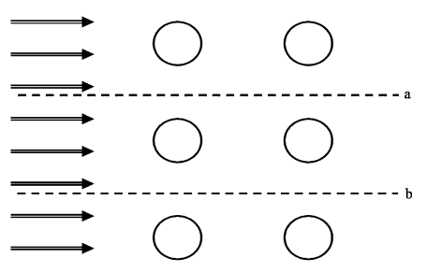
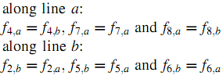
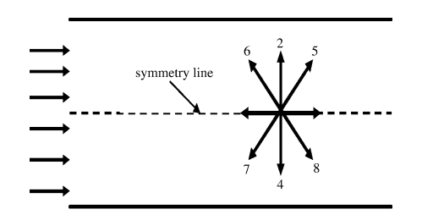
3- Periodic Boundary Condition
Periodic boundary condition become necessary to apply to isolate a repeating flow conditions. For instance flow over bank of tubes.
4- Symmetry Condition
Symmetry condition need to be applied along the symmetry line.

Slide 22
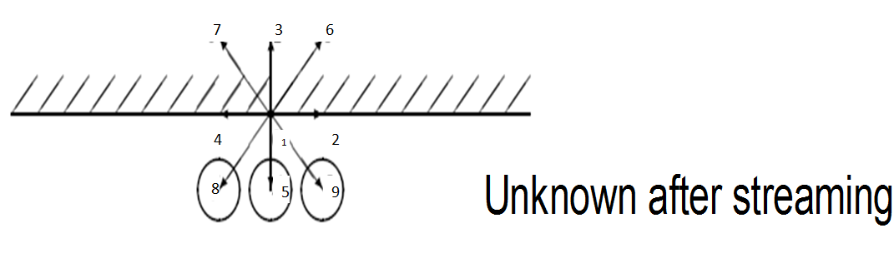
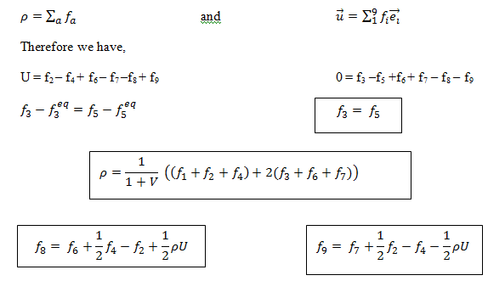
Boundary condition (Zou and He model)

Slide 23
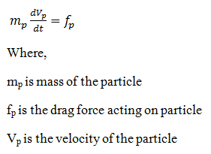
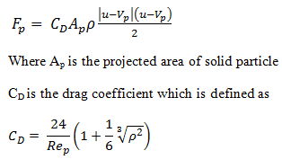
Particle equation

Slide 24

Convection by LBM
This represents the mixing that would occur when saltwater is sitting on top of freshwater.
CMWR 2004
Notes:
This represents the mixing that would occur when saltwater is sitting on top of freshwater.

Slide 25

Convection by LBM
This is a fun simulation of heat rising from below causing convection currents.
CMWR 2004
Notes:
This is a fun simulation of heat rising from below causing convection currents.

Slide 26
Advantages of Lattice Boltzmann Method
Macroscopic continuum equation, Navier Stoke, the LBM is based on microscopic model. LBM does not need to consider explicitly the distribution of pressure on interfaces of refined grids since the implicitly is included in the computational scheme.
The lattice Boltzmann method is particularly suited to simulating complex fluid flow
Represent both laminar and turbulent flow and handle complex and changing boundary conditions and geometries due to its simple algorithm.
3D can be implemented with some modification
It is not difficult to calculate and shape of particle

Slide 27
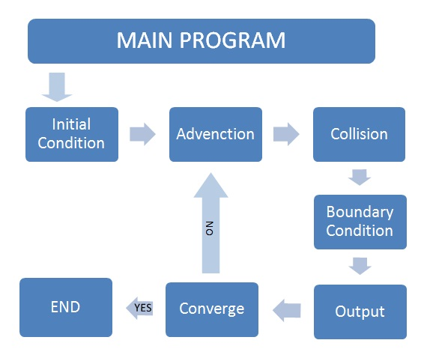
Simulation algorithm

Slide 28
Thank you
I hope, this research can contribute to human development.

